Slide 1
Data Analysis CREDIT ONE

Slide 2
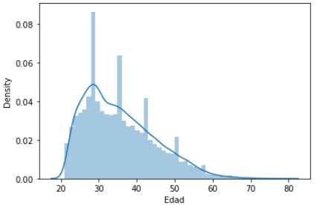
Project analysis slide 6
Demographic Distribution
Population concentrated between 25 and 40 years of age
Average: 35 years
Min: 21 years
Max: 79 years

Slide 3
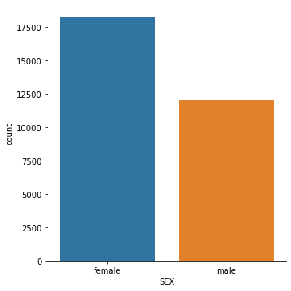
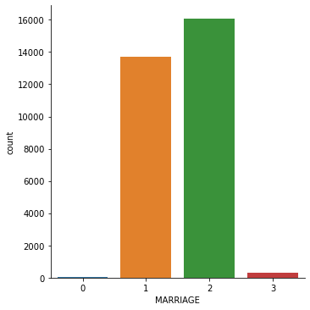
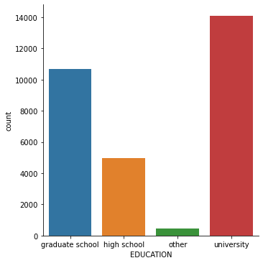
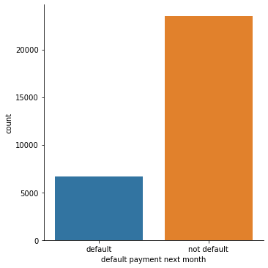
Project analysis slide 2
Client Analysis
About 5000 more women than men
College students are the most likely to apply for credit.
Single and married people donate the most credits
The default rate of all data is 22%.

Slide 4
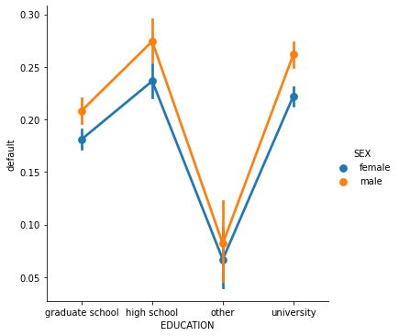
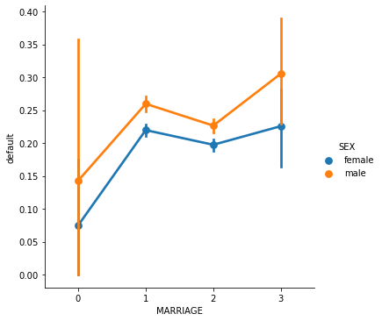
Project analysis slide 6
Default factors from clients
It seems that men, less educated people and divorced people tend to generate more defaults than the rest.

Slide 5
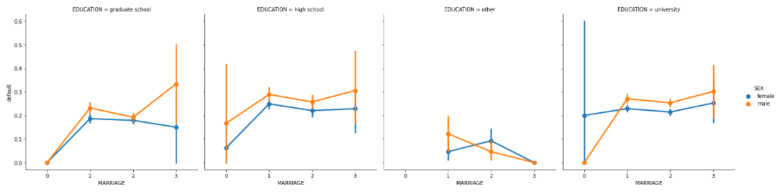
Project analysis slide 6
Default factors from clients
If we separate between these variables we realize that indeed, being a divorced man increases the chances of defaulting, however, it is ambiguous between schooling when it comes to going into more detail.

Slide 6
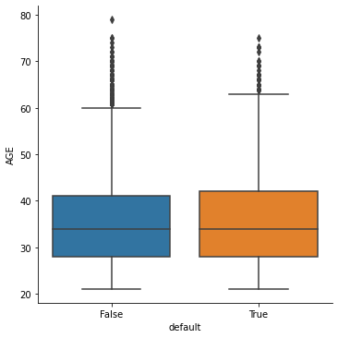
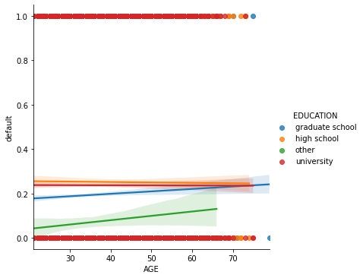
Project analysis slide 6
Default factors from clients
It appears that age is not such an influential factor in determining a person's default. There is no steep slope and we have very similar averages.
Is there a logical reason for this?
Let's remember that the age distribution varies between 25 and 40 years, a young population where there is a variety of marital status and schooling, so there is no significant pattern with age.

Slide 7
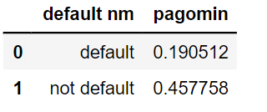
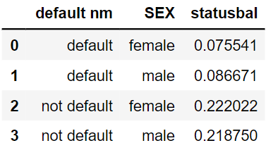
Project analysis slide 6
CAREFULL!
45% of the total number of people who were not defaulted have used the minimum payment many times.
And of the total number of non-defaulting individuals, both men and women, 22% have used the minimum payment many times and have a negative balance higher than the average of those with negative balances.
This means that there is a good percentage of people who owe and do not default because they use the minimum payment as a resource but in the future may DEFAULT and alter the analysis of this report.

Slide 8
Thank You

